Slide 1


Bureau of Energy Efficiency
(A Statutory body Under Ministry of Power)
WEBINAR ON
DEMONSTRATION OF ENERGY EFFICIENCY PROJECT (DEEP) IN PAT SECTOR
Head Office
Energy Efficiency Services Limited
NFL Building, 5th & 6th Floor, Core – III,
SCOPE Complex,
Lodhi Road, New Delhi – 110003

Slide 2


Table of Contents
Overview of DEEP & Key activities
Program Objectives
Implementation Method
Stakeholders and Roles
DC Selection Criteria
Payment Terms for DCs
Current Status of DEEP
EOI Submission Process
Technology Sets covered
Way Forward
Technology Selection Matrix

Slide 3
Overview of DEEP
Agreement between BEE and EESL
To Demonstration of Energy Efficient Project (DEEP) in PAT industry
Aim of Program
Commercialization and Market transformation for Innovative Technologies
Objective
EESL will implement the DEEP projects
Enable ecosystem through upscaling
Phase 1 : 8 Technologies & 27 Projects
Phase 2 : Reach successful technology across PAT industry
Large scale deployment and implementation
Reduce specific energy consumption for PAT sectors
Demonstration of Innovative energy efficient technologies
Cost Reduction
High Efficiency
Reduce Carbon
Sustainability
Towards Cleaner Path
Duration for Phase 1 : April 22 to March 23 (One year)

Slide 4
Key Project Activities
Energy Efficiency
Saving
Market transformation
Identification/Finalization of Innovative Energy Efficient Technologies
Demonstration of Energy Efficient Technologies (EETs)
Selection of beneficiary PAT Industries
Development of IoT based M&V Platforms
Knowledge Dissemination and Capacity Building
Upscaling of Demonstrated Technologies (Phase-II)

Slide 5

Stakeholders and Role
Bureau of Energy Efficiency
Ministry of Power
Project Governing Body
Joint Technical Working Committee
Sector Experts
EESL
PMU
PAT CELLS
OEMS
INDUSTRY ASSOCIATIONS
EAs & EMs
Project Stakeholders and member of JTWC
SDAs

Slide 6
Demonstration of Energy Efficiency Project (DEEP)
MoU Date: 24th March 2022
Objective: To upscale commercialization of innovative EE technologies across PAT sector for designated consumers
Offerings:
  Phase I: Undertake projects in 27 facilities for 8 new technologies
  Phase II: Upscale technology for DCs
Project Fund allocation (INR 63.99 Cr)
  Demo Stage: 45.6 Cr Fund
  Upscale: 13.20 Cr Fund
  Tenure: Initially till March 2023 (likely to be extended by 1 year)
Financial Model: Upfront payment through BEE funds and DC contribution

Slide 7

Stakeholders and Role
Bureau of Energy Efficiency (BEE) and JTWC
Overall facilitation of program at National Level
Approval on funds and process
Energy Efficiency Services Ltd. (EESL)
Successful implementation of Program
Monitoring of Programme
Desk study, Feasibility, M&V, IoT, DPR
Supporting and monitoring EESL for implementation
Event organisation
Process Defining
Cashflow management
State Designated Agencies (SDA) and PAT Cell/EmAEAs
Invite all sector DCs, PAT cell, AEAs including neighboring states
Support EESL/BEE for event organisation
Logistic Support in organizing workshop
Receiving Expression of Interest from DCs.
PAT cell official’s follow-up for timely submission of EoIs.
Facilitate signing of MoUs, agreements, etc.
Awareness and capacity building for DEEP project.
Key decisions on technology selection
Support for implementation
Provide techno-commercial offer
Designated Consumers (DCs)
Original Equipment Manufacturer (OEM)
Submit EoI
Approval for project
Support for M&V
EPC of project
Approval for Implementation of project
Suggest more Innovative technologyies

Slide 8
Program Objectives
Identify Energy Efficient technologies
Financing models to support replication of EE projects in DCs
Demonstration of the Identified technology
To build up IOT based Monitoring and verification protocol for the technology
Demand aggregation for the Identified technology in the clusters
Creation of Revolving Fund

Slide 9
Implementation Methodology
ESCO mode
Baseline & M&V
Agreement
Documenting and videography
Repayment
Desk Research and feasibility
Technology identification for the DCs
DEMO of technology
MSME units in the cluster
Bulk procurement
Economic of Scale
Implementation and vendor management
Sharing of DEMO results
Upscaling of the project

Slide 10






Implementation Methodology
Receiving of
Stage 1 - EoI
Evaluation & Screening
Evaluation and Screening
Agreement Signing between EESL – DCs
Baseline study & DPR preparation
Procurement, Installation & commissioning of technology
Measurement and Verification
Knowledge Dissemination
Upscaling of successful technology
Desk Research (Validation of technology & DC selection criteria)
Shortlisting of Innovative technology
Receiving of
Stage 2- EoI

Slide 11
Technology Selection Criteria
Technology Selection Criteria
S. No. | Criteria | Sub Criteria | Minimum Qualifying Criteria | Priority
1 | Energy Efficiency/ Generation | % Improvement over baseline consumption of the project boundary (not plant level) | 10% or above | Mandatory
2 | Financial Viability | Payback Period (PBP) | less than 3 years | Mandatory
3 | Replicability | % of DCs to accept within the sector | 25% of the targeted sector | Any two shall be met
4 | Availability | At least 3 technology providers | Yes
5 | Lead time | Short Term (up to 6 months) Medium Term (up to 12 months) Long term (>12 months) | Highest Priority – Short- & Medium-Term projects Less Priority – Long Term
6 | Cross Sector application | No. of sector | At least 2 sectors

Slide 12
DCs Selection Criteria
S. No. | Criteria | Sub Criteria | Qualifying Criteria | Weightage for selection
1. | Percentage Upfront contribution by DC | Total contribution of project cost* by DCs (In % of project cost) | Min. 30% of total project cost | 50%
2 | Overall contribution | Total contribution of project cost by DCs (In INR) | INR | 50%
If the sum of score of 1 and 2 is same, following marking will adopted for the selection of beneficiary units.
I | Specific energy saving | Cost basis (toe/Lakh Rs.) | Energy saved per INR lakh of investment | 50%
II | Specific emission saving | Cost basis (tCO2/Lakh Rs.) | GHG mitigated per INR lakh of investment | 50%
*Estimated project cost includes the cost of equipment and associated accessories, freight, and insurance, unloading, installation and commissioning, etc.
Note :-
Number of technologies that shall be demonstrated in a single DC/group of DC be limited to,
  Maximum 2 technologies
  Project cost not more than INR 200 Lakhs in one single DC/group of DC. Maximum Project cost ceiling Rs. 4.57 Cr
The beneficiary industry for demo (Phase-1) will be selected through competitive bidding offer whoever get highest marking in evaluation of EOI and remaining industries will be provided support with different business model ( Phase-2).

Slide 13
Payment Terms for DCs
Milestone | Description
Milestone-1 | ABG equivalent of 10% of estimated technology cost at the time of singing of the agreement. Valid for duration till 100% receipt of DC’s cost contribution
Milestone-2 | 50% of DC’s contribution within 10 days from the date of the delivery of equipment at site
Milestone-3 | Balance 50% of DC’s contribution within 10 days from the date of successful commissioning of equipment
Milestone-4 | ABG will be returned on receipt of 100% amount of DC’s cost contribution

Slide 14
Current Status Snapshot
  MOU signed dated 24th Feb 2022 and sanction 30th March
  Mobilization Advance released by BEE
  3 JTWC meetings: 13th May, 1st Aug & 4th Nov
  9 nos. of tech. approved by JTWC
  1st set of EOI published for 4 technologies & completed
  Internal PMU and desk research agency deployed
  Selection Criteria for DC selection finalized
  Physical Workshops conducted at Ahmedabad (12th July) , Delhi (20th July) , Ranchi (30th Nov) in addition to many online ones .
  Selection criteria for ranking DCs for short-listing finalized
    – 81 EOIs received 212 prospective projects techno-commercially appraised for short-listing
    -50 viable with 80 equipments

Slide 15


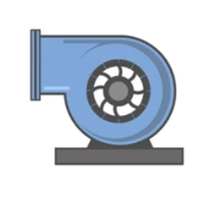

First Set of Approved Technologies
Technology 1 :
Micro Turbine
Status of EoI-A
No. of Technologies : 4
EoI-Stage 1 : Received from DC
EoI-Stage 2 : Receiving under progress
Expected to start technology implementation : April 2023
Technology 2 :
Energy Efficient Screw Compressor
Technology 3 :
Turbo Blower
Technology 4 :
Low Grade Waste Heat Recovery

Slide 16
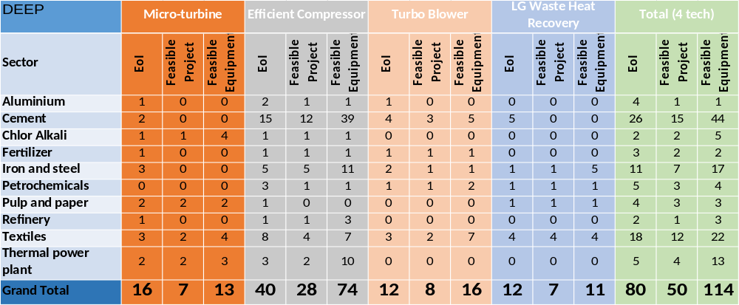
Sector wise EoI-Stage 1A (4 technologies)

Slide 17
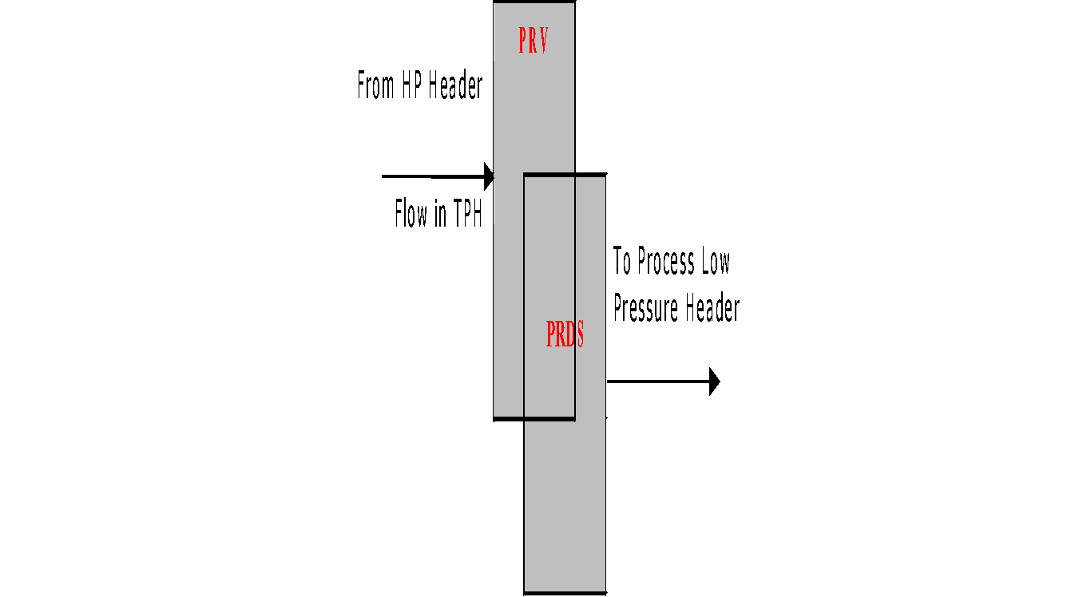
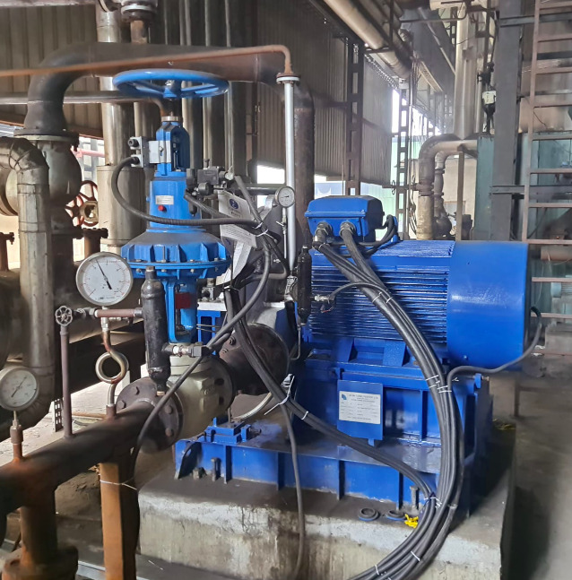
Back Pressure Micro-turbine for Power Generation
Before Implementation
After Implementation
Boiler house equipped with PRV to reduce boiler pressure from 10.5 kg/cm2 to process pressure requirement of 3.5 kg/cm2 ; Differential pressure wasted.
Differential pressure utilized for captive power generation by installation of micro-turbine; Enthalpy in steam used to run turbine which in turn is used to generate electricity; 8 tph boiler can generate 90 kWh power.
The turbine is coupled directly to a small Induction Generator, which synchronizes the power produced with the local plant grid without the need of sophisticated and expensive control mechanisms. The system can utilize saturated steam; it becomes highly beneficial for industries using saturated steam. The pressure energy, which otherwise was wasted can be conserved and utilized to generate useful electricity. The turbine is designed for various flow-rates; so that maximum generation efficiency can be ensured at various flow rates.

Slide 18
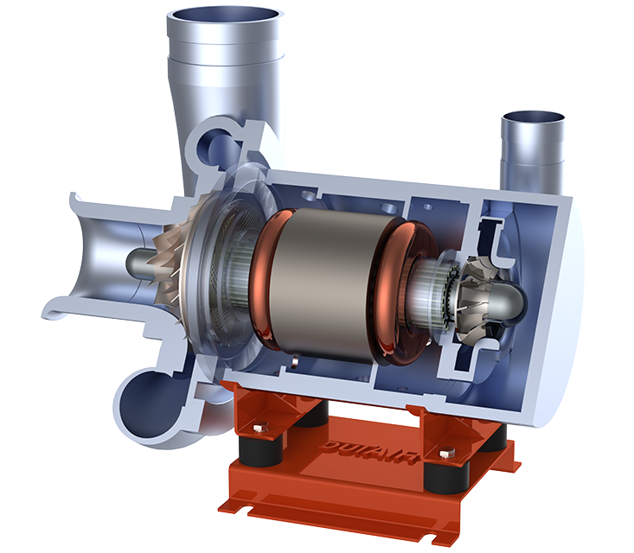
Approved Technology - 2
Turbo Blower
Industrial Sector
Cement
Highlights
Energy Saving : (20–25)%
Payback Period : 2.2 – 3 years
No. of Projects : 3-4
Textiles
Pulp & Paper
Fertilizers
For the same application turbo blower can provide 1.7 times the same torque output with upto 82% ή as compared to conventional blowers

Slide 19
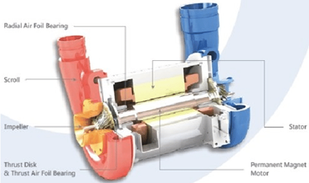
Approved Technology -3
Drive enabled Screw Compressor with Permanent Magnet (PM) motor
Industrial Sector
Cement Plant
Highlights
Energy Saving : (15 -20)%
Payback Period : 1.5 – 2 years
No. of Projects : 3-4
Fertilizers
Chemicals
Textile
No rotor loss
No transmission loss
No wear & tear
Low noise and maintenance

Slide 20
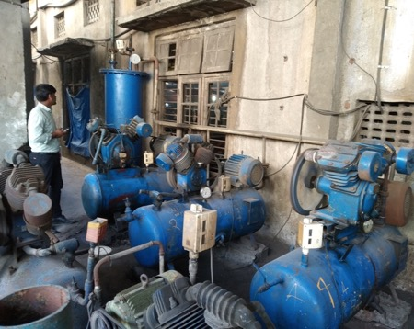
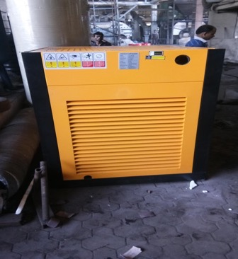
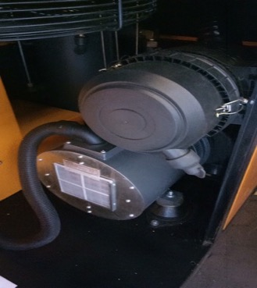
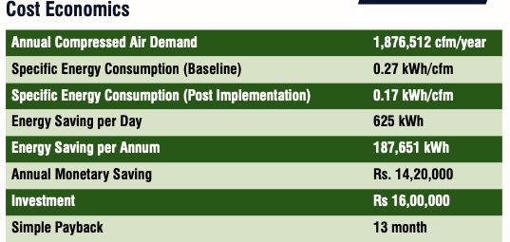
Implemented-case study (1)
Permanent magnet Screw compressor with VFD
Energy Efficient Screw compressor
VFD - based PM motor
Old reciprocating compressor
40% Reduction in specific power consumption
Operating single compressor instead of 10 compressor
Maintenance cost reduction by 50%
Noise free operation and improvement in working environment.
Replication potential in 30% of the cluster’s units

Slide 21
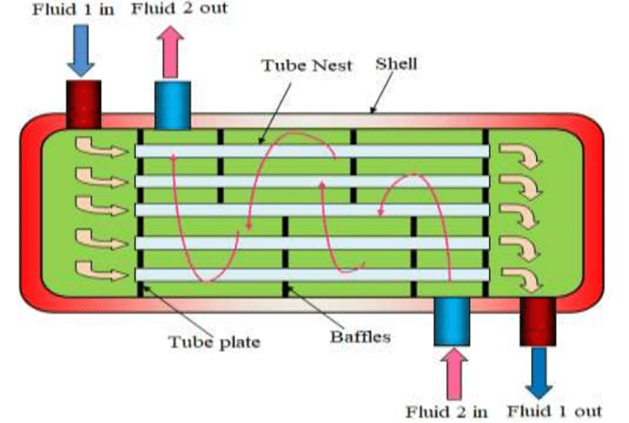
Approved Technology - 4
Low Grade Waste Heat Recovery System
Industrial Sector
Cross sector as per application
Benefits
Energy Saving : ( 10-15)%
Payback Period : 2.5 – 3 Years
No. of Projects : 3-4

Slide 22
Second set of Technologies (EoI-2A/ 3A)
5. High Grade Waste Heat Recovery system (2A1)
    Scrap Preheating with Electric Arc furnace Exhaust
    Regenerative Burner for Reheating Furnace
    Recuperator
6. Cooling solutions from waste heat recovery (2A2)
7. Industrial automation with an objective of energy efficiency improvement along with Plant Performance Management/ Process Optimisation (3A1)
8. Inlet air cooling system from waste heat recovery (3A2)
9. IE4 motors with VFD (3A3)

Slide 23

Second Set of Approved Technology
(5.1) Scrap Preheating with Electric Arc furnace Exhaust
(5.2) Regenerative Burners for Reheating Furnaces
(5.2) Recuperator
Technology 5 :
High Grade Waste Heat Recovery

Slide 24
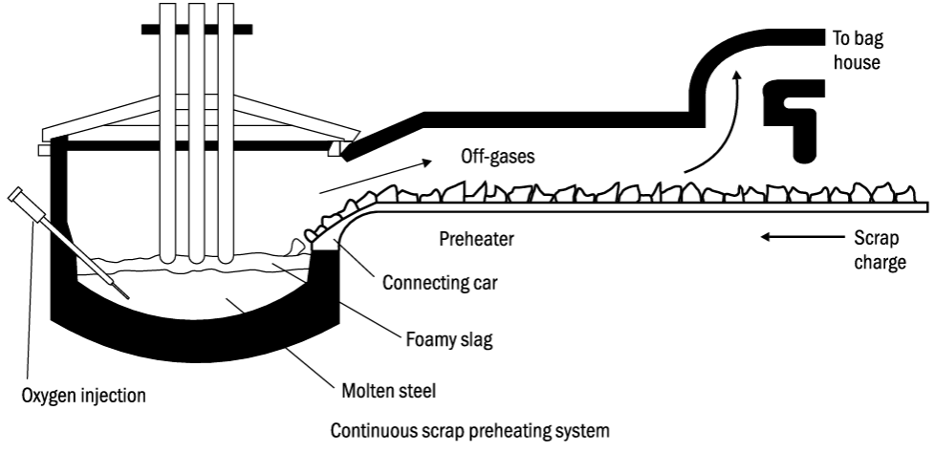
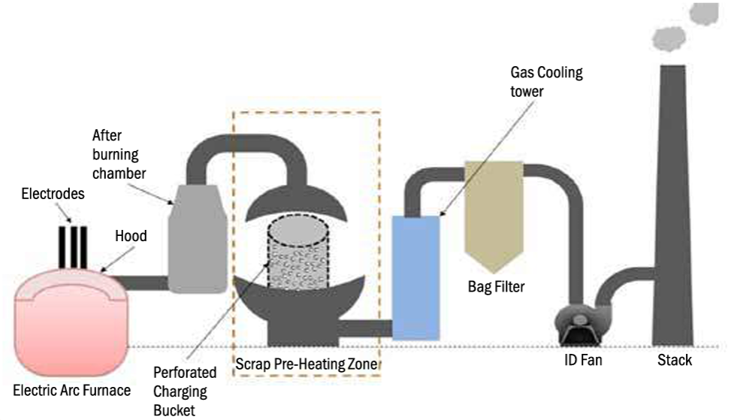
5.1 Scrap Preheating with Electric Arc furnace Exhaust
Continuous Scrap preheating system
Bucket preheating system
  5.1 Scrap Preheating with Electric Arc furnace Exhaust
Electric arc furnace involves a high-temperature melting operation. The average temperature of the melt inside the furnace is about 1650 °C. The waste gases or off-gases from the furnace leave at about 900-1200 °C, which is quite high, wasting significant energy. About 20% of the input energy is carried away by the off-gases. This waste heat available in off-gases can be effectively recovered and reused which would help in reducing the overall energy consumption of the furnace. One of the major options for WHR is preheating input scrap. The exact energy savings depend on the type of scrap, size, the temperature of off-gases and residence time.
The most established scrap preheating technologies applicable for EAFs are:
Bucket preheating system
Continuous scrap preheating system

Slide 25
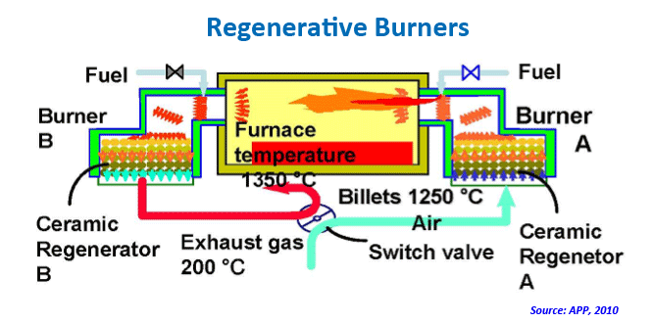
  5.2 Regenerative Burners for Reheating Furnaces
  5.2 Regenerative Burners for Reheating Furnaces
The regenerative burners fire alternately to recover the sensible heat from waste gas for the preheating of combustion air.
The systems are capable of obtaining high-temperature preheated air exceeding 1100℃ in a short timeframe, by repeated heat accumulation and combustion.
Recover between 85 -90 % of the heat from the furnace waste gases
Application temperatures range from 1100ºC up to 1500 °C.
Fuel consumption can be reduced by up to 60 %.
Used for Melting/Reheat/Treatment Furnaces, & kilns

Slide 26
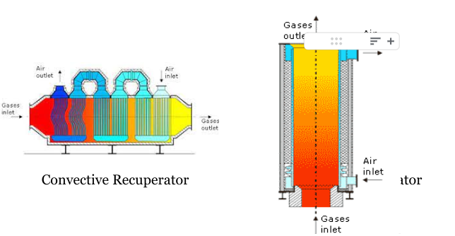
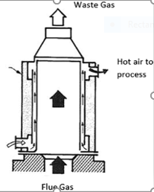
  5.3 Recuperator
  5.3 Recuperator
In a recuperator, heat exchange takes place between the flue gasses and the air through metallic or ceramic walls. Ducts or tubes carry the air for combustion to be preheated, the other side contains the waste heat stream. Recuperators are classified based on the principle of heat transfer by radiation, convection, or combinations. Recuperators are constructed out of either metallic or ceramic materials. Metallic recuperators are used in applications with temperatures below 1050 °C, while heat recovery at higher temperatures is better suited to ceramic tube recuperators which can operate with hot side temperatures as high as 1500 °C and cold side temperatures of around 950 °C. For maximum effectiveness of heat transfer, hybrid recuperators are used.
Recuperators are classified based on the principle of heat transfer by radiation, convection
( May have combination also)

Slide 27
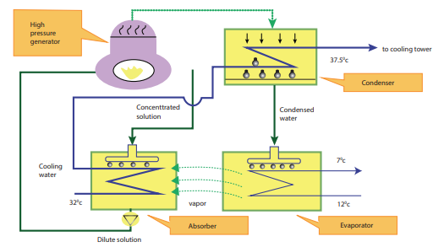
6. Space Cooling using VAM
Vapour Absorption Machine
A vapour absorption chiller (VAM) is a machine to produce chilled water using heat sources such as steam, hot water, and gas. A fluid pair of lithium bromide and water are used in commercial VAM. The refrigerant used is actually water, as that is the working medium that experiences a phase change and causes the cooling effect. The second fluid that drives the process is salt, generally lithium bromide. Heat is used to separate the two fluids, when they are mixed in a near vacuum environment.
Courtesy-Thermax
Schematic diagram of Vapour Absorption Machine

Slide 28

7. Industrial Automation
7.1 Online Coal GCV Analyser
Benefits:
Helps in real-time analysis of coal GCV & Reduction in loss of generation due to poor coal quality
7.2 Automatic Blowdown-Control System
Benefits
With automatic blowdown, one can avoid keeping the TDS too low than what is required & can Minimise energy loss from boiler blowdown
7.3 Intelligent Flow Controller (IFC) for Compressed Air Network
It monitors the demand side rate of change of pressure and releases only the required amount of storage air to satisfy the peak demand instead of starting additional compressors. Thus reduction in the mass of air and a reduction in the load period of compressors leads to energy savings

Slide 29
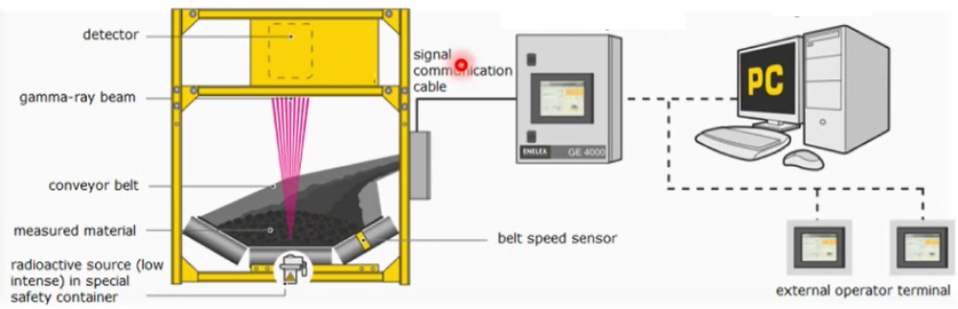
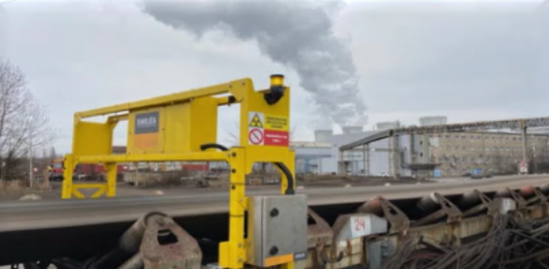
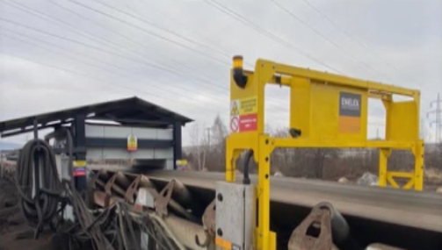
7.1 Online GCV
Quality of coal is a big concern
A plant usually sources coal from various mines
  Resorts to blending – African Coal, Thailand, India Coal
The coal from various sources varies in
  Calorific value
  Ash content
  Moisture content
Online GCV is installed on the coal conveyor belt
It provided instant monitoring of key quality parameters
Sensors are radioactive
CQMS is a must for all DCs

Slide 30
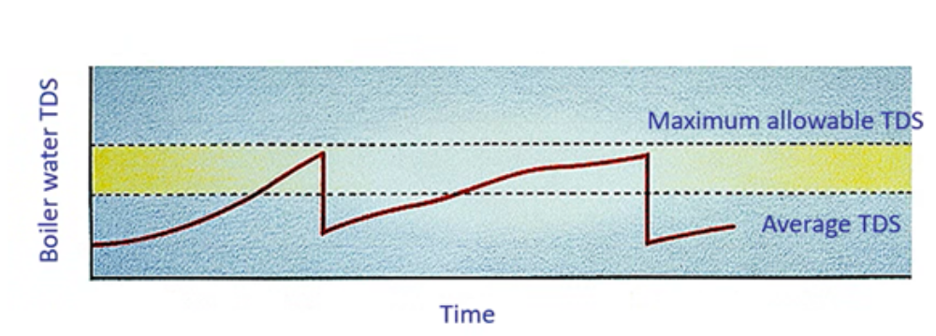
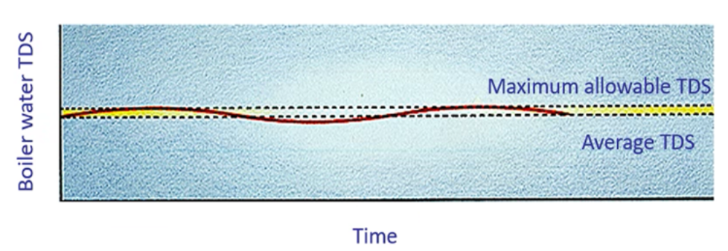
7.2 Automatic Blow-Down
TDS is usually defined by Boiler Manufacturer
Usually varies from 2000 (LP/MP) to 4500 (HP)
High blowdown
  results in low TDS
  Wastage of heat energy
Less Blowdown
  High TDS/Quality of Steam
  High Fuel consumption
Manual Blowdown
Automatic Blowdown

Slide 31
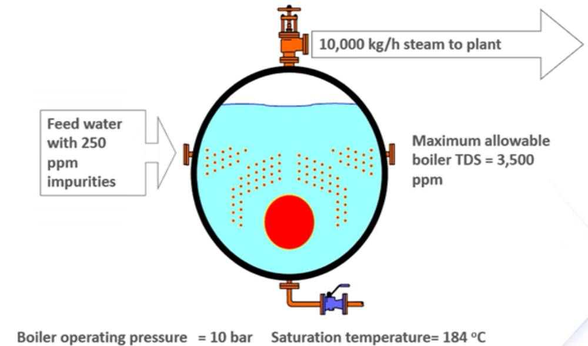
Automatic Blow-Down
Blow Down Quantity
BD = F X S
B - F
Feed Water TDS (F) – 250 ppm
Current TDS (B) – 2000 ppm
Steam Rate (S) – 10000kg/h
Initial Blow Down (kg/h) – 1430 (14.3%)
Target TDS – 3500 ppm
New Blow Down (kg/h) – 770 (7.7%)
Steam Savings – 660kg/h
Steam Rate – Rs. 2 / kg
Annual Savings – Rs. 9.5 Lakhs

Slide 32
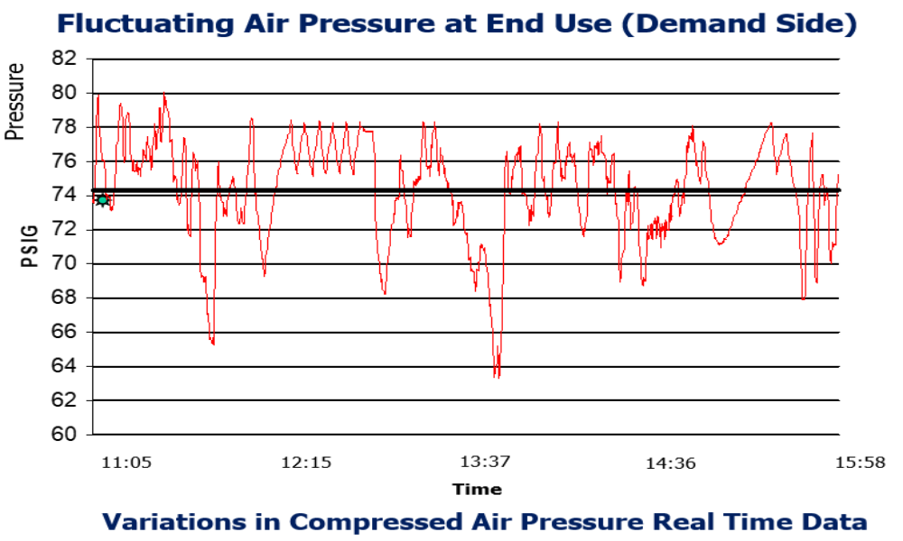
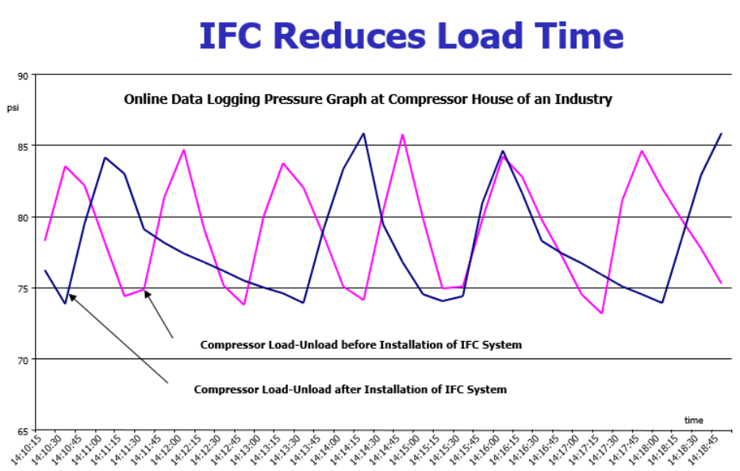
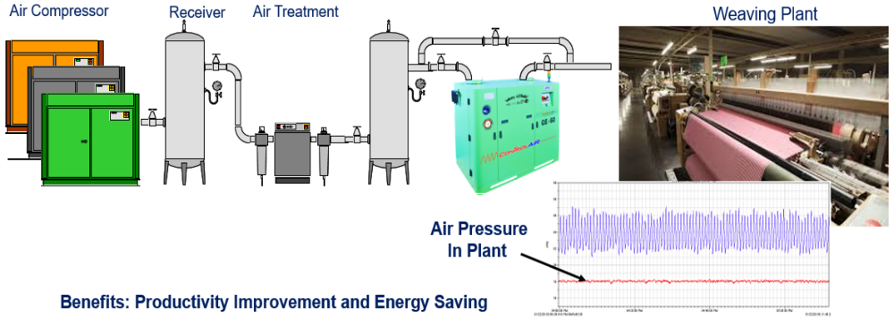
7.3 Intelligent Flow Controller for CADN
CA typically uses 10% of a plant’s total energy (4th largest utility cost)
Useful Output 10-15% of input (80% heat, 5-10% mechanical loss)
SSM – Compressor sizing, technology, inter-cooler, heat recovery
DSM – Piping sizing, VFD, IFC, remote monitoring
Demand at load end – dynamic leading to fluctuation in sys pressure
Higher pressure leads to higher air consumption
IFC helps smoothen CAD system and reduce load timing
Pressure control within +/- 1 PSIG (0.07Bar)

Slide 33
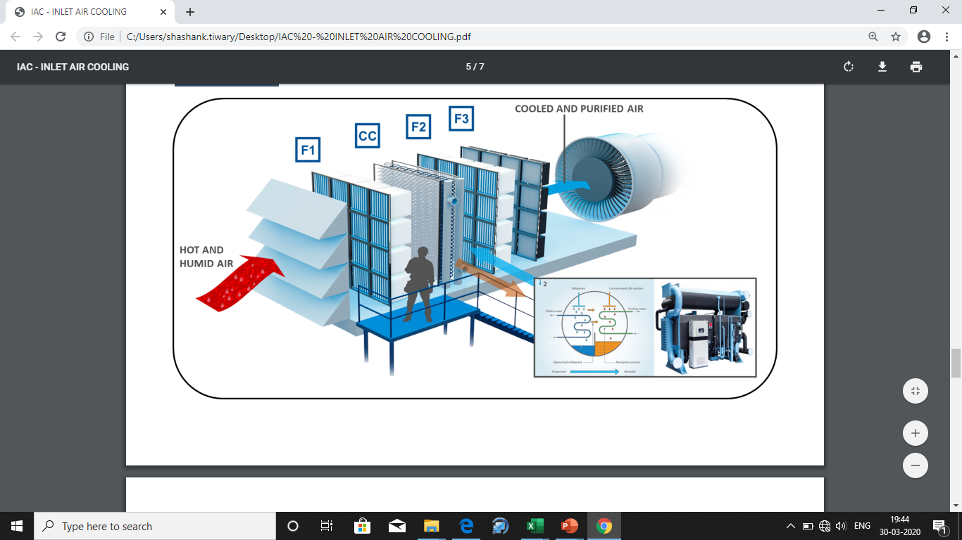
8. Inlet Air Cooling for Compressors
Compressors are designed to operate at specific atmospheric conditions
15 Deg C & 60% RH
De-rating can be as high as 20-25%
For a given volume mass flow rate will increase with cooler air
Cooler air is dense and dryer and hence easily compressed
This results in lower work by the compressor
Can help reduce 6 to 8% savings in compressor
GT heat rate may improve y same value
Reduction in repair and maintenance cost

Slide 34
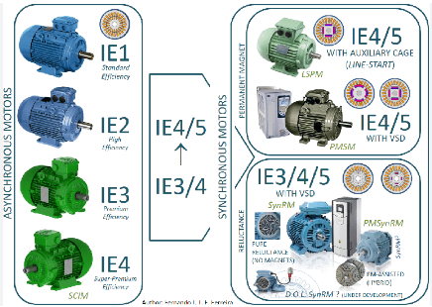
9. IE4 Motors with VFD
IE4 motors are also equipped for frequency converter (VFD) duty. By using IE4 motors together with a premium VFD there can be several benefits including better process control, energy savings and a reduced starting current. It can further reduce stress on mechanical equipment and the electrical supply network
Benefits:
High efficiency
Less maintenance
Lower operating temperatures
Less thermal stress on the motor, the motor bearings and terminals.
Enhanced motor life
Low operating cost
Efficiency
IE4 Super Premium Efficiency
IE3 Premium Efficiency
IE2 High Efficiency
IE1 Standard Efficiency

Slide 35
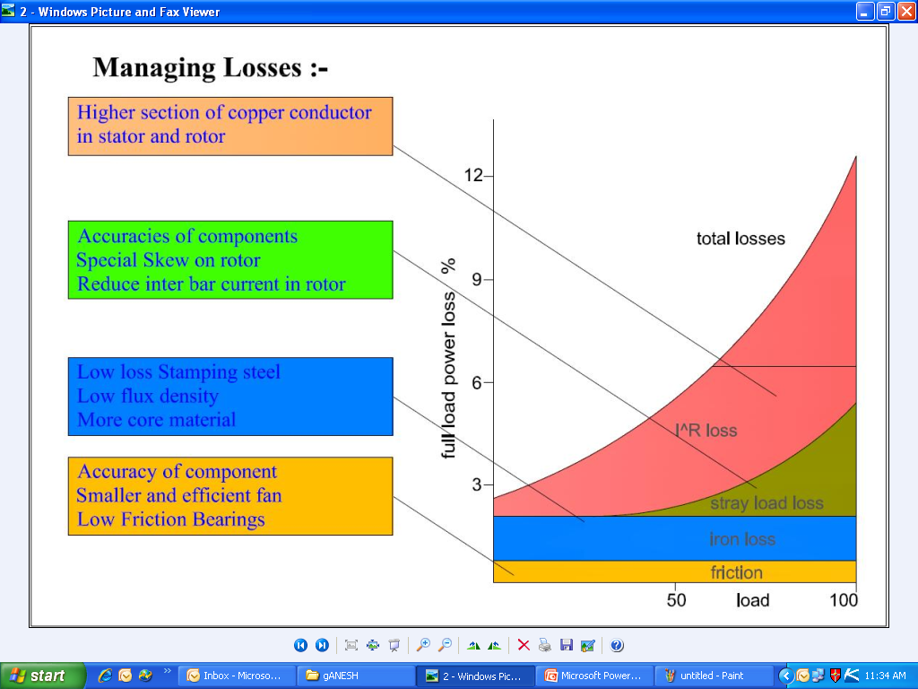
IE4 Efficiency values as per IS12615:2018
KW | 2-POLE |  |  | KW | 4-POLE |  |  | KW | 6-POLE
 | IE2 | IE3 | IE4 |  | IE2 | IE3 | IE4 |  | IE2 | IE3 | IE4
0.12 | 53.6 | 60.8 | 66.5 | 0.12 | 59.1 | 64.8 | 69.8 | 0.12 | 50.6 | 57.7 | 64.9
0.18 | 60.4 | 65.9 | 70.8 | 0.18 | 64.7 | 69.9 | 74.7 | 0.18 | 56.6 | 63.9 | 70.1
0.25 | 64.8 | 69.7 | 74.3 | 0.25 | 68.5 | 73.5 | 77.9 | 0.25 | 61.6 | 68.6 | 74.1
0.37 | 69.5 | 73.8 | 78.1 | 0.37 | 72.7 | 77.3 | 81.1 | 0.37 | 67.6 | 73.5 | 78.0
0.55 | 74.1 | 77.8 | 81.5 | 0.55 | 77.1 | 80.8 | 83.9 | 0.55 | 73.1 | 77.2 | 80.9
0.75 | 77.4 | 80.7 | 83.5 | 0.75 | 79.6 | 82.5 | 85.7 | 0.75 | 75.9 | 78.9 | 82.7
1.1 | 79.6 | 82.7 | 85.2 | 1.1 | 81.4 | 84.1 | 87.2 | 1.1 | 78.1 | 81.0 | 84.5
1.5 | 81.3 | 84.2 | 86.5 | 1.5 | 82.8 | 85.3 | 88.2 | 1.5 | 79.8 | 82.5 | 85.9
2.2 | 83.2 | 85.9 | 88.0 | 2.2 | 84.3 | 86.7 | 89.5 | 2.2 | 81.8 | 84.3 | 87.4
3 | 84.6 | 87.1 | 89.1 | 3 | 85.5 | 87.7 | 90.4 | 3 | 83.3 | 85.6 | 88.6
3.7 | 85.5 | 87.8 | 89.7 | 3.7 | 86.3 | 88.4 | 90.9 | 3.7 | 84.3 | 86.5 | 89.3
4 | 85.8 | 88.1 | 90.0 | 4 | 86.6 | 88.6 | 91.1 | 4 | 84.6 | 86.8 | 89.5
5.5 | 87.0 | 89.2 | 90.9 | 5.5 | 87.7 | 89.6 | 91.9 | 5.5 | 86.0 | 88.0 | 90.5
7.5 | 88.1 | 90.1 | 91.7 | 7.5 | 88.7 | 90.4 | 92.6 | 7.5 | 87.2 | 89.1 | 91.3
9.3 | 88.9 | 90.7 | 92.2 | 9.3 | 89.3 | 91.0 | 93.0 | 9.3 | 88.1 | 89.8 | 91.9
11 | 89.4 | 91.2 | 92.6 | 11 | 89.8 | 91.4 | 93.3 | 11 | 88.7 | 90.3 | 92.3
15 | 90.3 | 91.9 | 93.3 | 15 | 90.6 | 92.1 | 93.9 | 15 | 89.7 | 91.2 | 92.9
18.5 | 90.9 | 92.4 | 93.7 | 18.5 | 91.2 | 92.6 | 94.2 | 18.5 | 90.4 | 91.7 | 93.4
22 | 91.3 | 92.7 | 94.0 | 22 | 91.6 | 93.0 | 94.5 | 22 | 90.9 | 92.2 | 93.7
30 | 92.0 | 93.3 | 94.5 | 30 | 92.3 | 93.6 | 94.9 | 30 | 91.7 | 92.9 | 94.2
37 | 92.5 | 93.7 | 94.8 | 37 | 92.7 | 93.9 | 95.2 | 37 | 92.2 | 93.3 | 94.5
45 | 92.9 | 94.0 | 95.0 | 45 | 93.1 | 94.2 | 95.4 | 45 | 92.7 | 93.7 | 94.8
55 | 93.2 | 94.3 | 95.3 | 55 | 93.5 | 94.6 | 95.7 | 55 | 93.1 | 94.1 | 95.1
75 | 93.8 | 94.7 | 95.6 | 75 | 94.0 | 95.0 | 96.0 | 75 | 93.7 | 94.6 | 95.4
90 | 94.1 | 95.0 | 95.8 | 90 | 94.2 | 95.2 | 96.1 | 90 | 94.0 | 94.9 | 95.6
110 | 94.3 | 95.2 | 96.0 | 110 | 94.5 | 95.4 | 96.3 | 110 | 94.3 | 95.1 | 95.8
125 | 94.5 | 95.3 | 96.1 | 125 | 94.6 | 95.5 | 96.4 | 125 | 94.4 | 95.2 | 95.9
132 | 94.6 | 95.4 | 96.2 | 132 | 94.7 | 95.6 | 96.4 | 132 | 94.6 | 95.4 | 96.0
160 | 94.8 | 95.6 | 96.3 | 160 | 94.9 | 95.8 | 96.6 | 160 | 94.8 | 95.6 | 96.2
200 | 95.0 | 95.8 | 96.5 | 200 | 95.1 | 96.0 | 96.7 | 200 | 95.0 | 95.8 | 96.6
250 | 95.0 | 95.8 | 96.5 | 250 | 95.1 | 96.0 | 96.7 | 250 | 95.0 | 95.8 | 96.6
315 | 95.0 | 95.8 | 96.5 | 315 | 95.1 | 96.0 | 96.7 | 315 | 95.0 | 95.8 | 96.6
355 | 95.0 | 95.8 | 96.5 | 355 | 95.1 | 96.0 | 96.7 | 355 | 95.0 | 95.8 | 96.6
375 | 95.0 | 95.8 | 96.5 | 375 | 95.1 | 96.0 | 96.7 | 375 | 95.0 | 95.8 | 96.6
400 | 95.0 | 95.8 | 96.5 | 400 | 95.1 | 96.0 | 96.7 | 400 | 95.0 | 95.8 | 96.6
450 | 95.0 | 95.8 | 96.5 | 450 | 95.1 | 96.0 | 96.7 | 450 | 95.0 | 95.8 | 96.6
500 up to 1000 | 95.0 | 95.8 | 96.5 | 500 up to 1000 | 95.1 | 96.0 | 96.7 | 500 up to 1000 | 95.0 | 95.8 | 96.6
Modified Slot Design to reduce leakage flux
Premium Quality Core
Thinner Laminations
More Steel for core length
More Copper for conductor
Low Tenp. Rise
Increased rotor bar cross section (less R)
High pr. AL die cast to reduce rotor loss
Superior bearings and efficient fan design

Slide 36
Suggestion for Innovative Technologies
More innovative technologies are being explored
DCs / Experts/ Other may suggest niche technologies to JTWC
  Feedback shared on following email ID deep@eesl.co.in
  Documents related to innovative technology may be attached like case study, Research Paper, Concept note, Vendor details etc.
Suggested technologies may vary based on the desk-research, BEE priorities and JTWC approval.
Note :
In subject of email for suggestion of innovative technology will have following format
<Type the name of an Innovative technology>_ <Type Applicable Name of the Sector>

Slide 37
Scope of Work
Included in Project Cost
Excluded from Project Cost
Manufacturing of Equipment
DPR Preparation
Feasibility Study
Required Instruments and BoPs
Freight of Supplied Items
Installation of Supplied Material
Testing and Commissioning of Supply
Measuring and Validation
Integration with existing system
Civil Job
Preparation of Earthing
Extra Piping/ Cabling beyond the battery limit
Any service beyond the battery limit
Additional Taxes
Statutory approval required

Slide 38
Process of EoI Submission
Visit to EESL site by one of the following method mention on page No. 9 of EoI document
Download excel sheet for interested technology/ technologies through provided links in REOI /EOI form sample file tab
Fill and submit the EoI Microsoft form
Fill the required information
Upload the filled pdf file for desired technology in EOI form for DEEP project file name <Tech. name>_<PAT Reg. No.>_<Name of DC>
Repeat the procedure from step 3 to 5 for submission of EoI for stage 2
Scan QR to visit the site
Login through link provided
Convert file to pdf
For any further queries, the DCs can write us at email: - deep@eesl.co.in or
contact to Mr. Mangesh Potdar on Mobile no.
(+91) 9650603458

Slide 39
EoI-2 Submission Process
Email will be received to short listed DCs from EESL for Request for Stage-2 EoI with following details,
Scope of Work
Tentative cost of Technology Implementation
Tentative Lead time
In stage-2 EoI, DCs has to submit following,
% contribution of Technology Implementation
Acceptance of payment term
JTWC will review and analyse the received EoI in stage 2 and shortlist DCs for implementation.

Slide 40

EoI Submission Process - 1
Step -1 for EoI submission
Go to page No. 9 of EoI document shared via email
Option-1
Option-1 : Directly visit the EESL website through following link available on page no. 9 of EOI document,
Corporate Driven – Energy Efficiency Services Limited (eeslindia.org)
Option-2 : Simply scan QR code with mobile app and login to EESL website
Option-3 : click on link “Expression of Interest – DEEP (Stage-1)”
Option - 2
On website :- Energy Efficiency Services Limited (eeslindia.org)
https://eeslindia.org
Option - 3

Slide 41
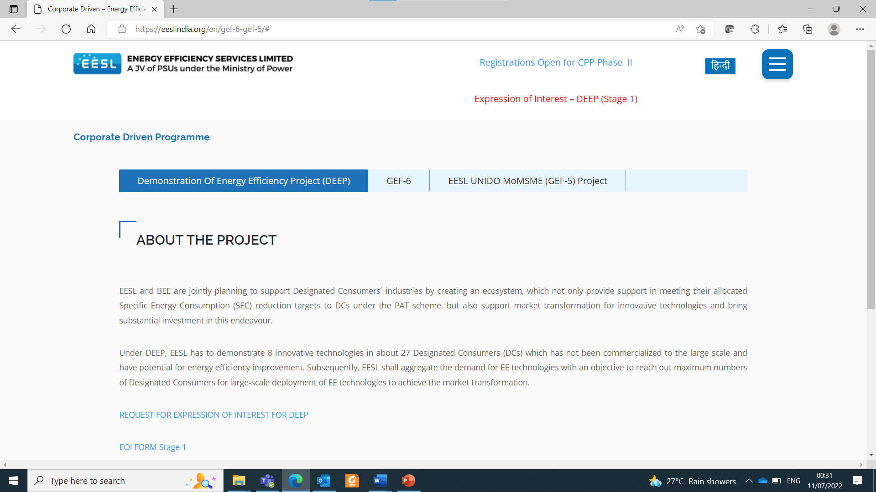
EoI Submission Process -2
Step -2 : Following webpage will be appeared after step 1
Step-2 : open EOI Form stage 1

Slide 42
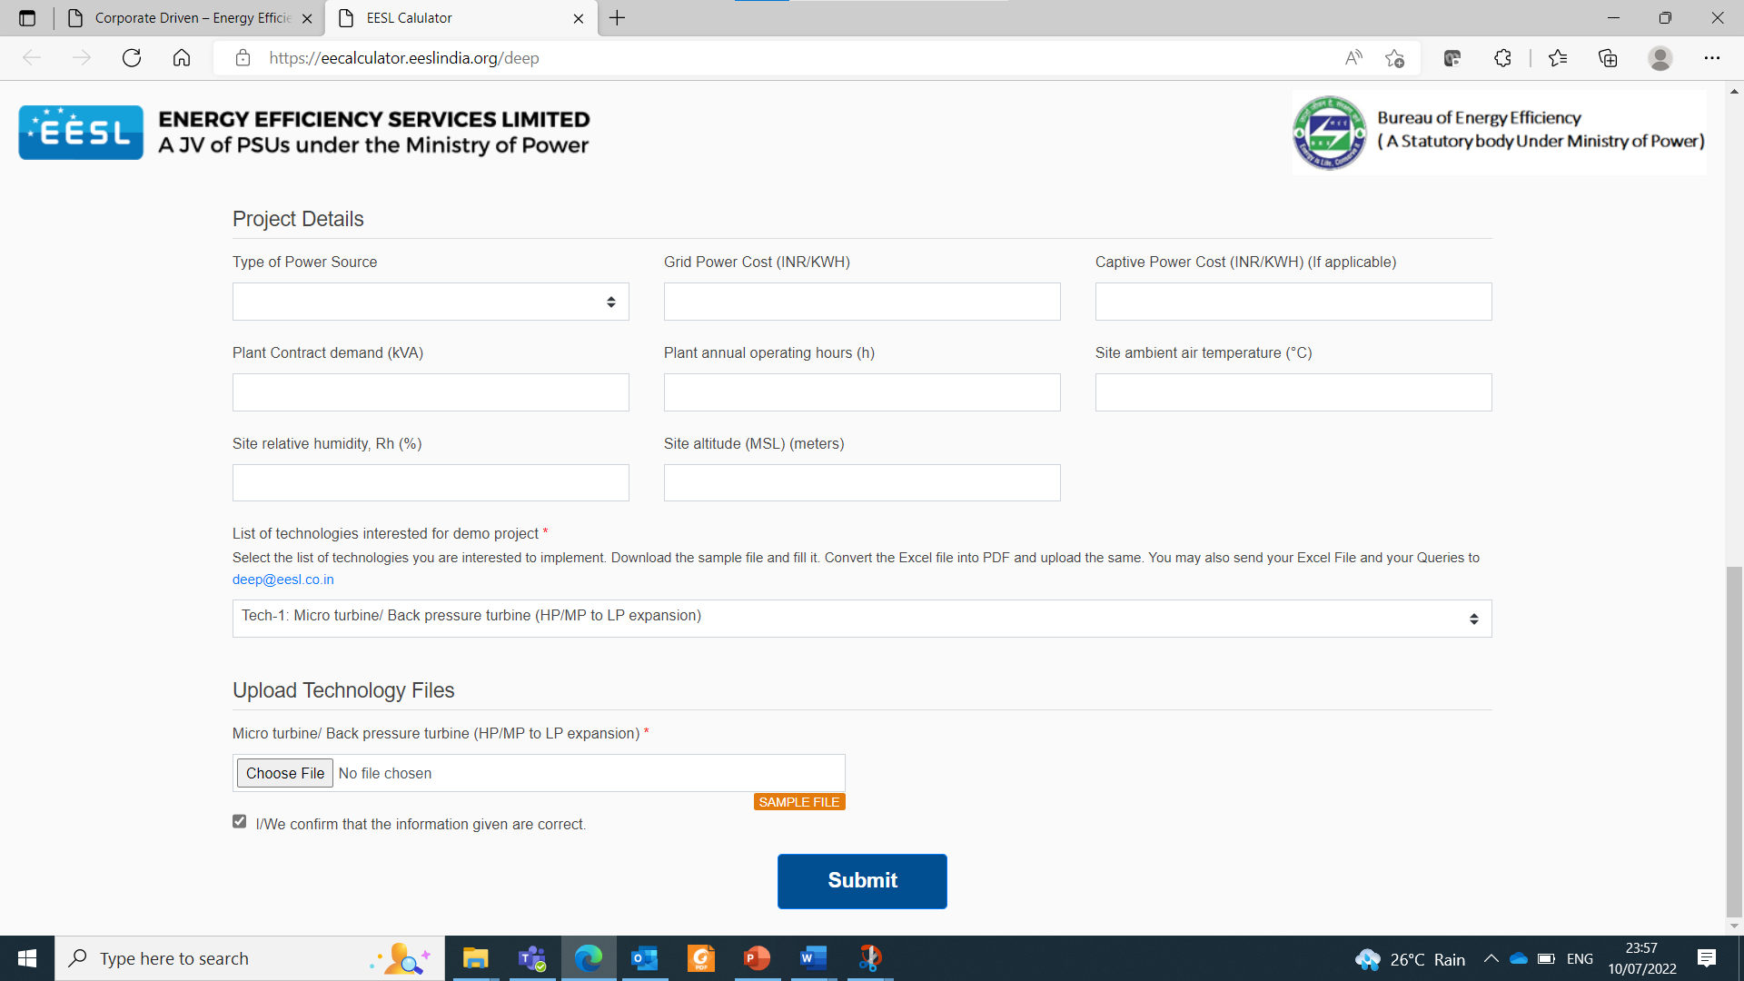
EoI Submission Process – 3
Step -3 : Fill details and select required technology
Step 3 select technology, can select multiple
Selected technology upload option will open

Slide 43
EoI Submission Process – 4
Step -4 : download selected technology file by click on sample file
Step 4 Download selected technology file by click on “sample file”

Slide 44
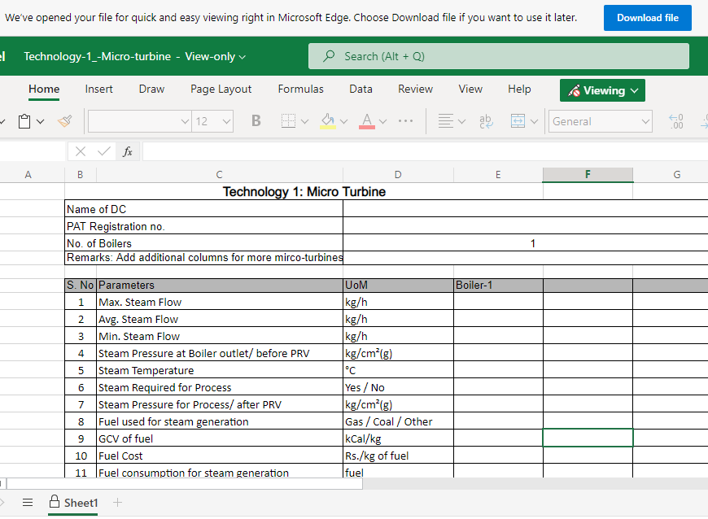
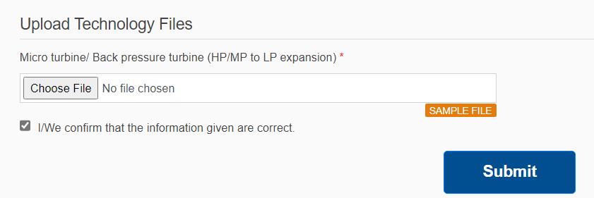

EoI Submission Process – 5
Step -5 : Fill Inputs
Step-5 : Click on “Download file” to download the blank file
Note : Here e.g. of Micro turbine is considered. Repeat the same for other technologies.
Step-6 : Fill the requested information in excel file, convert it into pdf, upload and submit
Note :
File name <tech. name>_< PAT reg. No.>_<Name of DC>
After uploading click on Submit button
File uploading options will open as per technology selection
Here You Have Successfully Submitted Your EoI!

Slide 45

Thank You
Bureau of Energy Efficiency
( A Statutory body Under Ministry of Power)

Slide 46


Question
&
Answer
Bureau of Energy Efficiency
( A Statutory body Under Ministry of Power)

